Slide 1
Tracking Accuracy Comparison HTC Vive vs. Vicon
Yuanqing Hong, Xin Jin

Slide 2
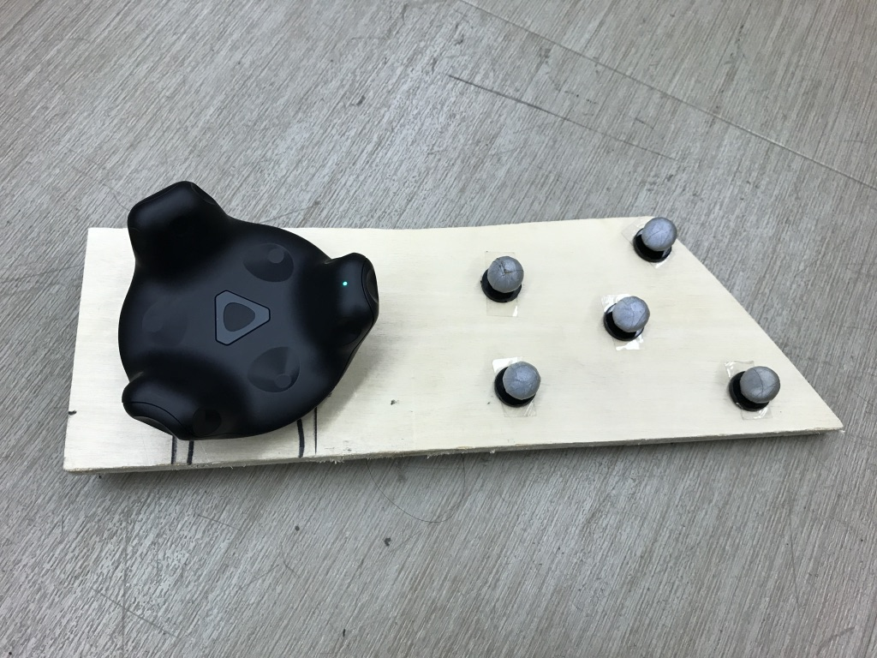
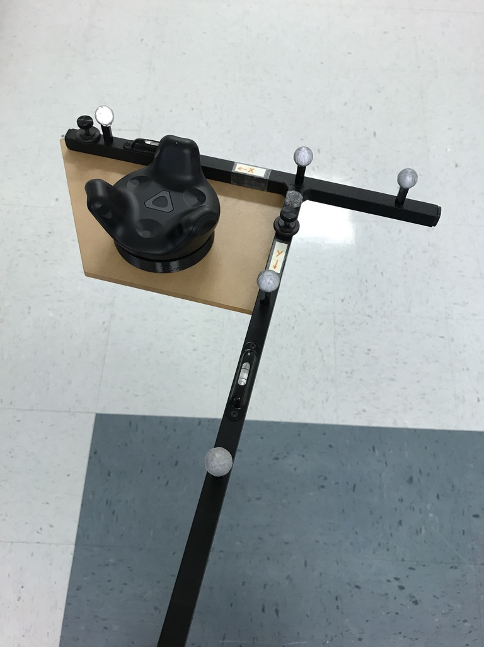
Method
Computer2
Unity
UDP
Computer1
Vicon
Labview

Slide 3
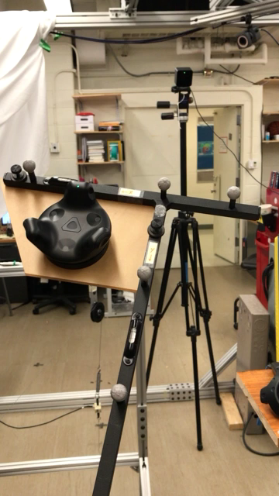

Slide 4
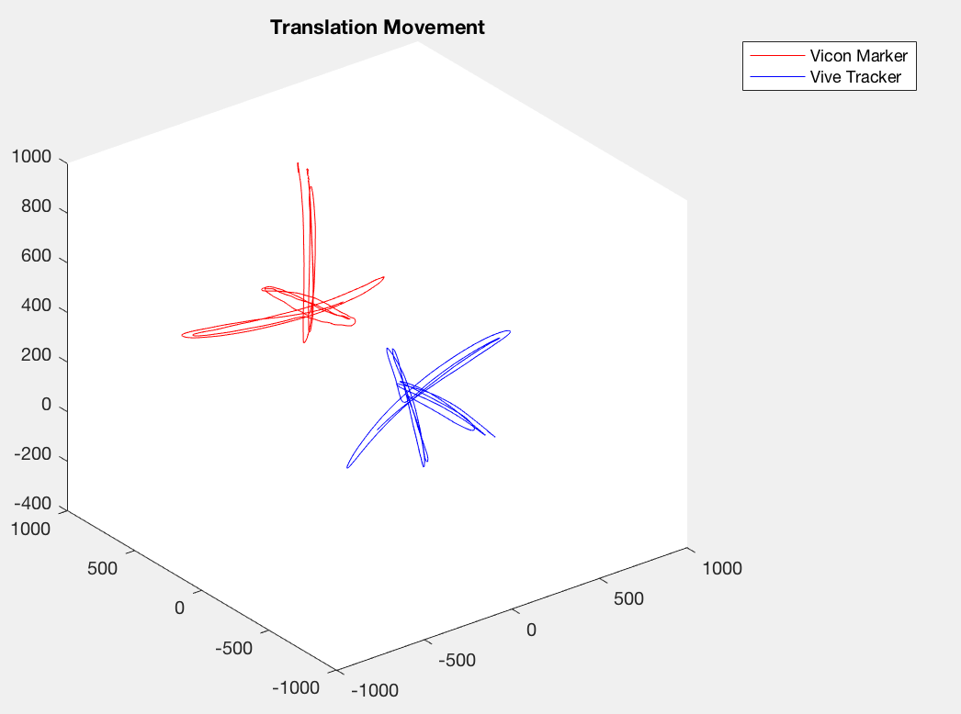
Experiments
3 Sets of Data
Translation Movement
Circle Movement
Rotation Movement
Raw Data

Slide 5
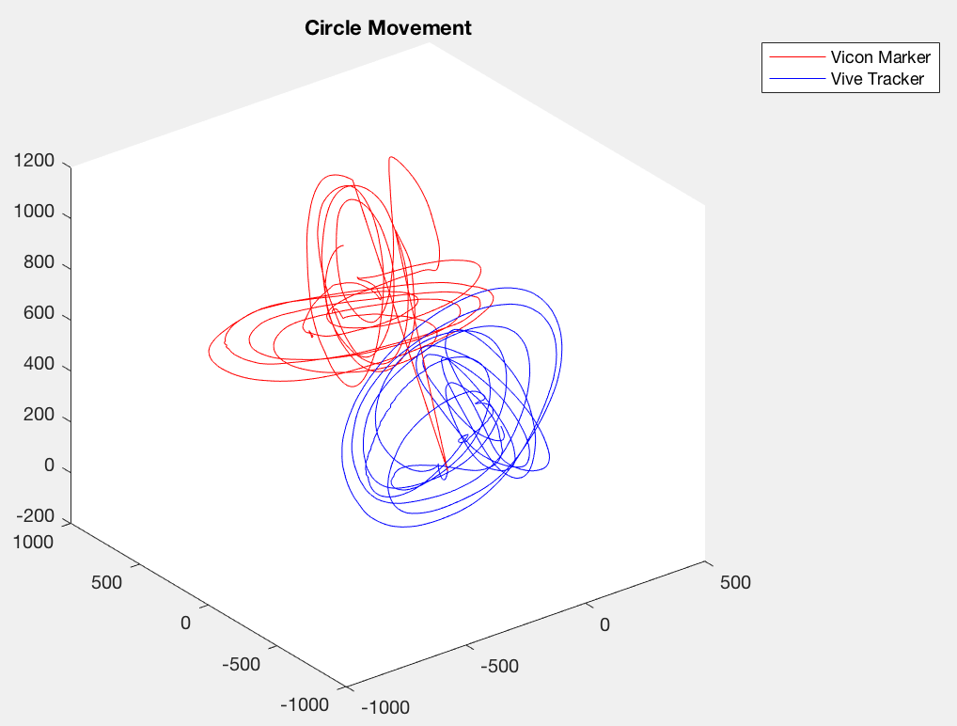
Experiments
3 Sets of Data
Translation Movement
Circle Movement
Rotation Movement
Raw Data

Slide 6
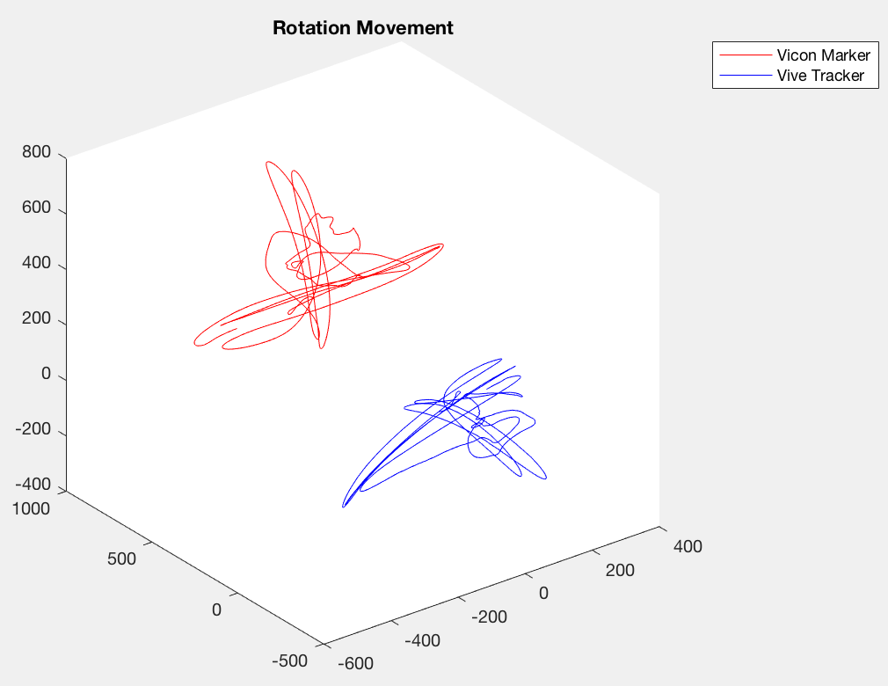
Experiments
3 Sets of Data
Translation Movement
Circle Movement
Rotation Movement
Raw Data

Slide 7
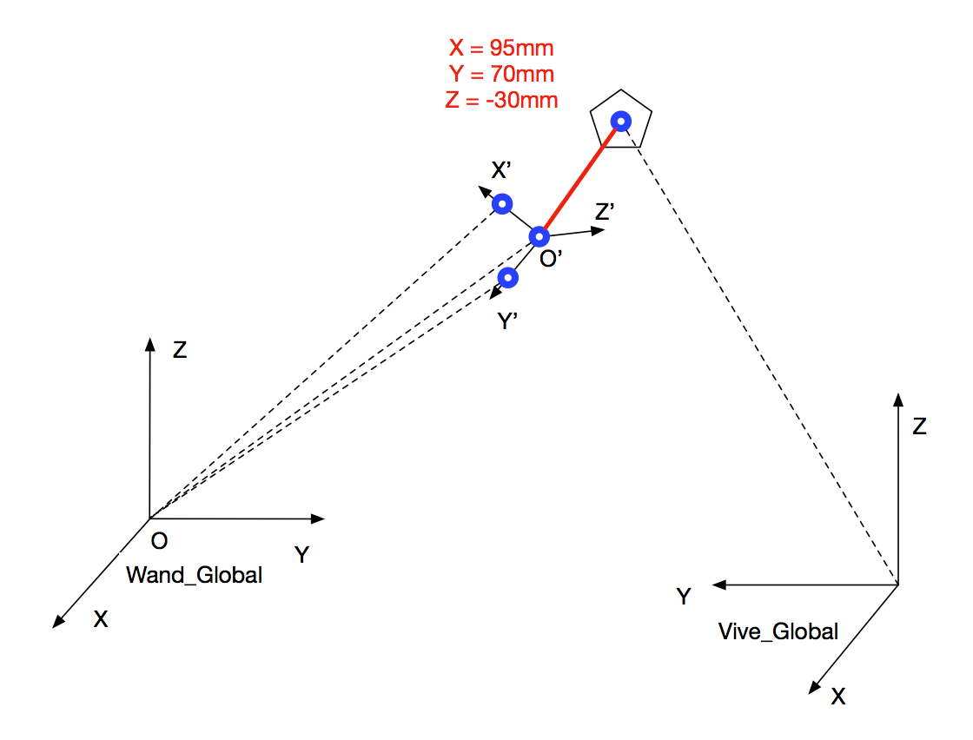
Coordinates Mapping

Slide 8
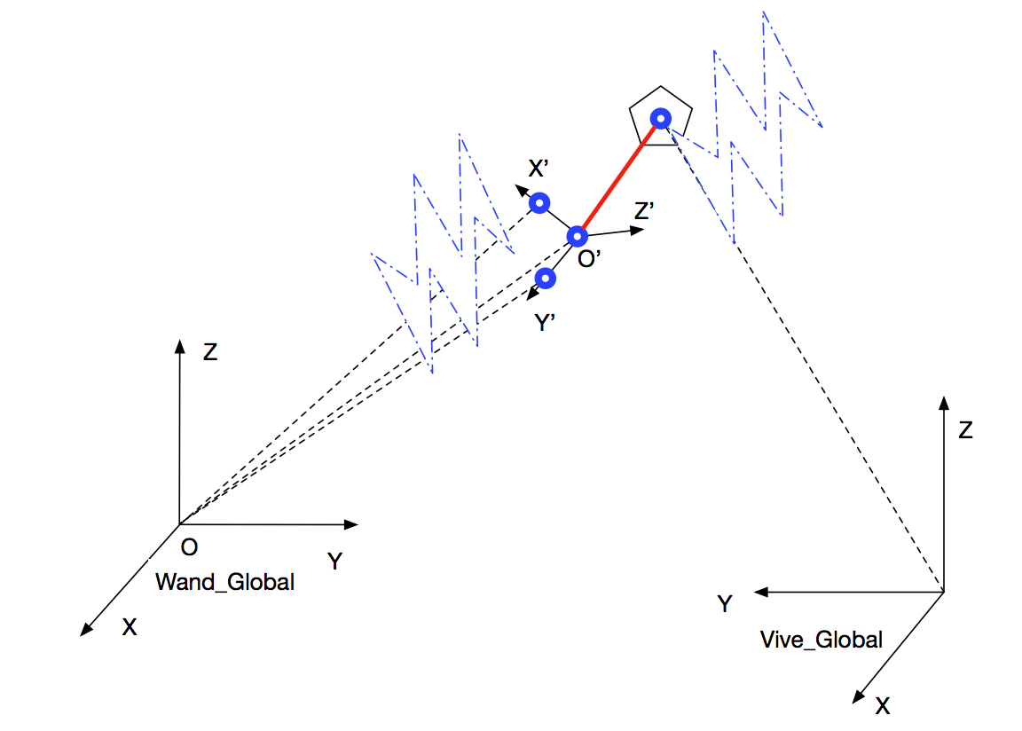
Coordinates Mapping

Slide 9
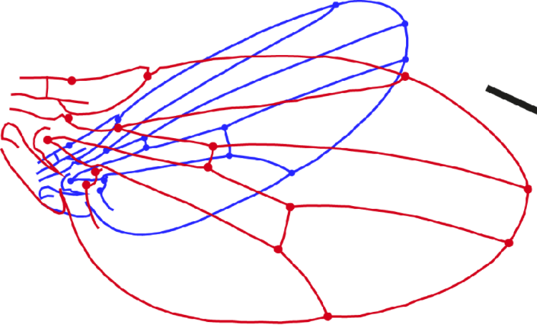

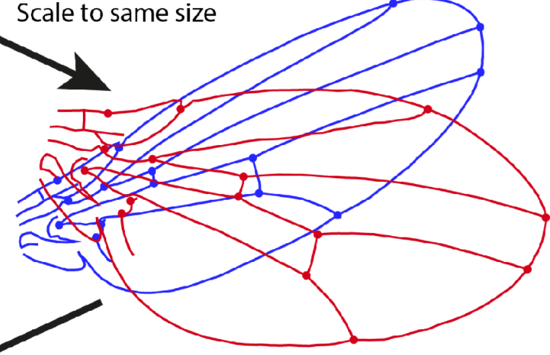
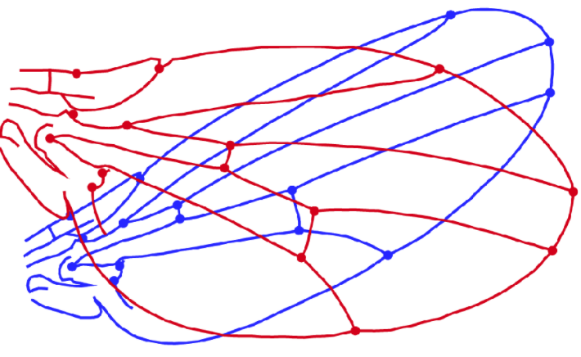
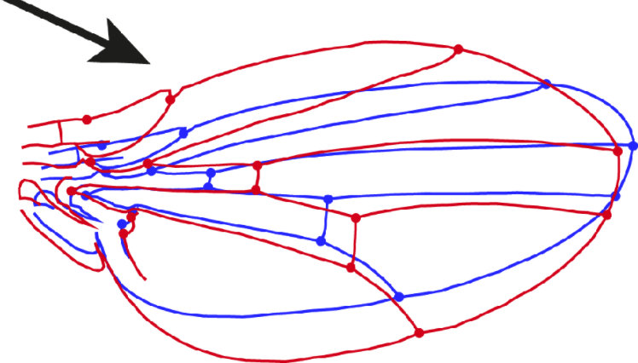
Procrustes Analysis
Procrustes Analysis:
A form of statistical shape analysis
Scale
1000 (Vicon [mm] & Vive [m])
Translation
Centroid at origin
Rotation
Optimal rotation matrix that minimize squared distance
Scale
Translation
Rotation

Slide 10
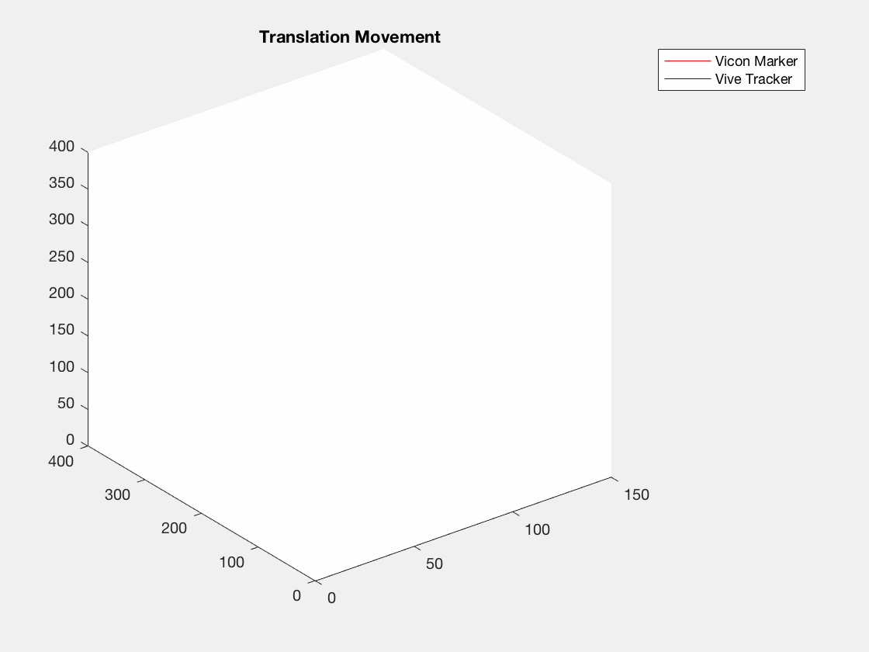
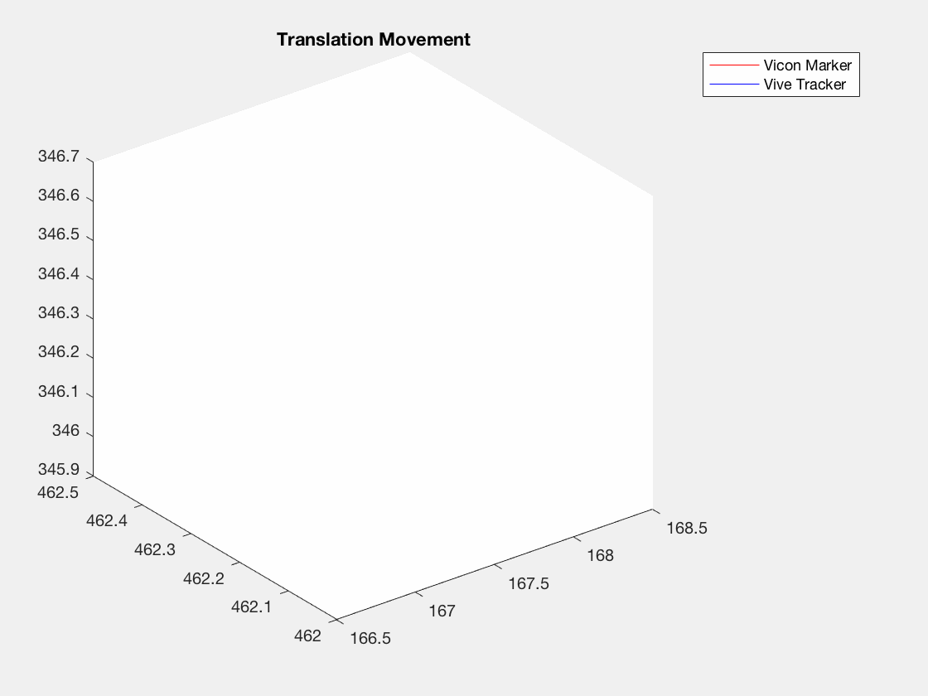
Translation Movement
Geometric Error:
RMS(root mean square) Error: 2.7mm
Max Error: 10.2mm

Slide 11
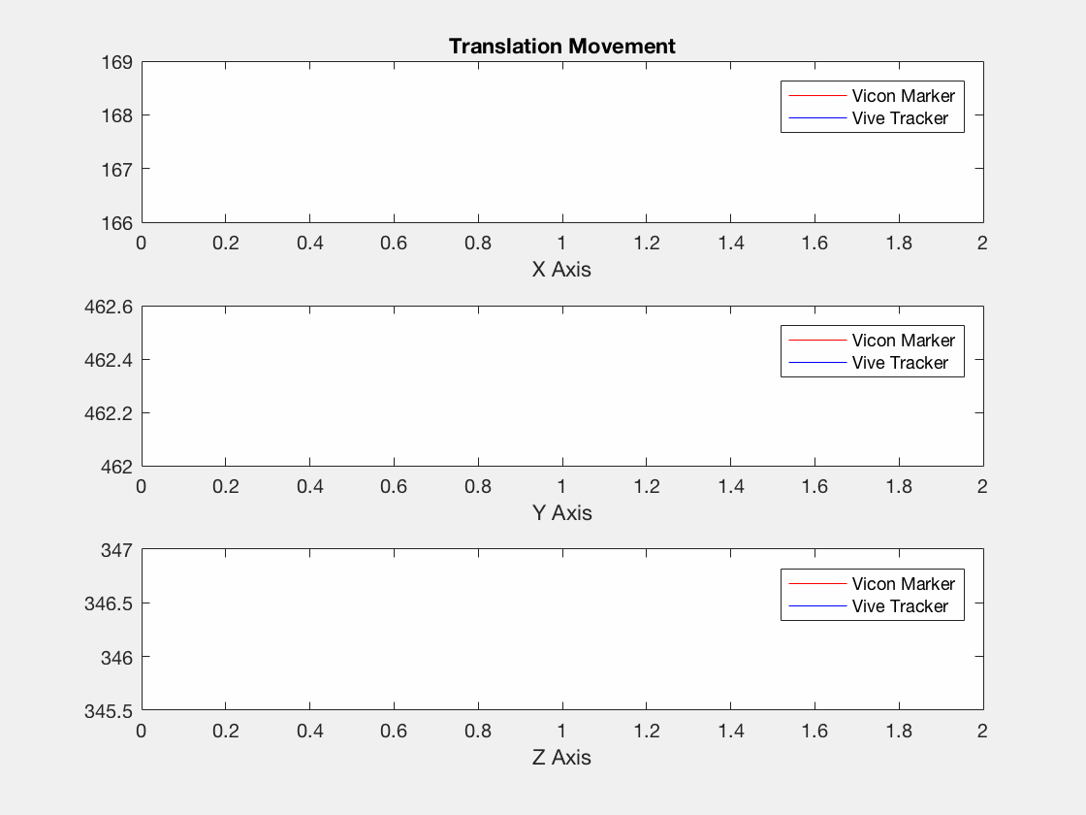
Error (mm)
RMS
Max
X Axis
1.7
6.8
Y Axis
1.3
5.1
Z Axis
1.6
7.2

Slide 12
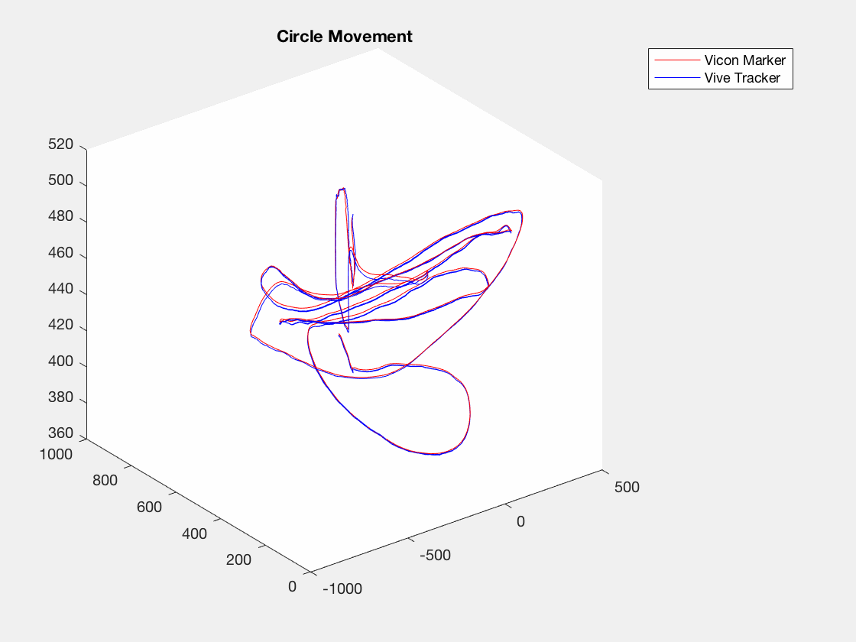
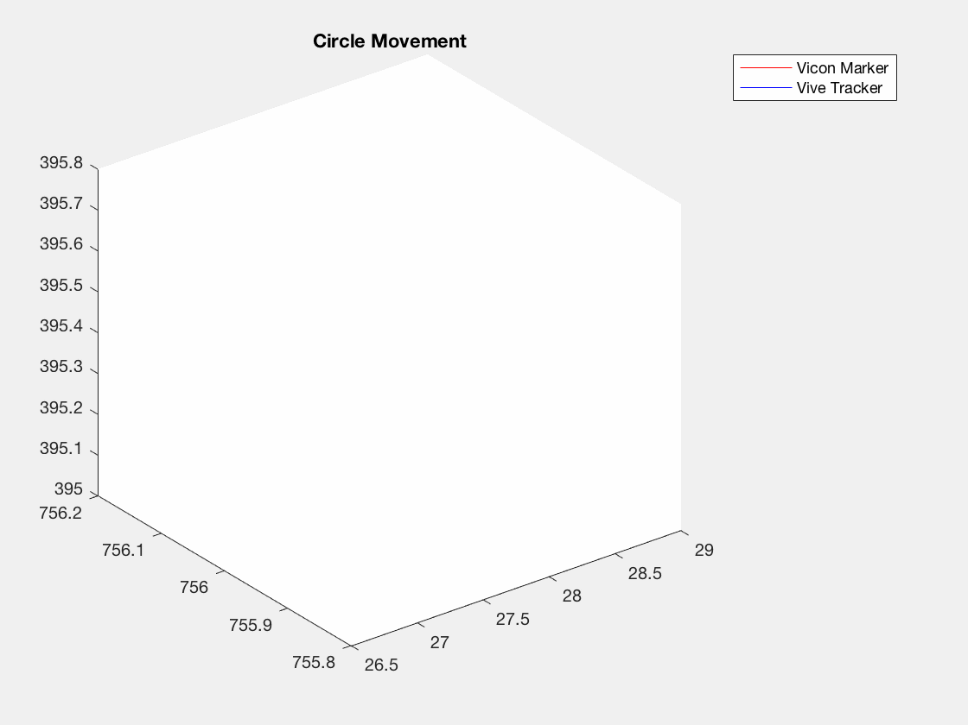
Circle Movement
Geometric Error:
RMS(root mean square) Error: 6.7mm
Max Error: 32mm

Slide 13
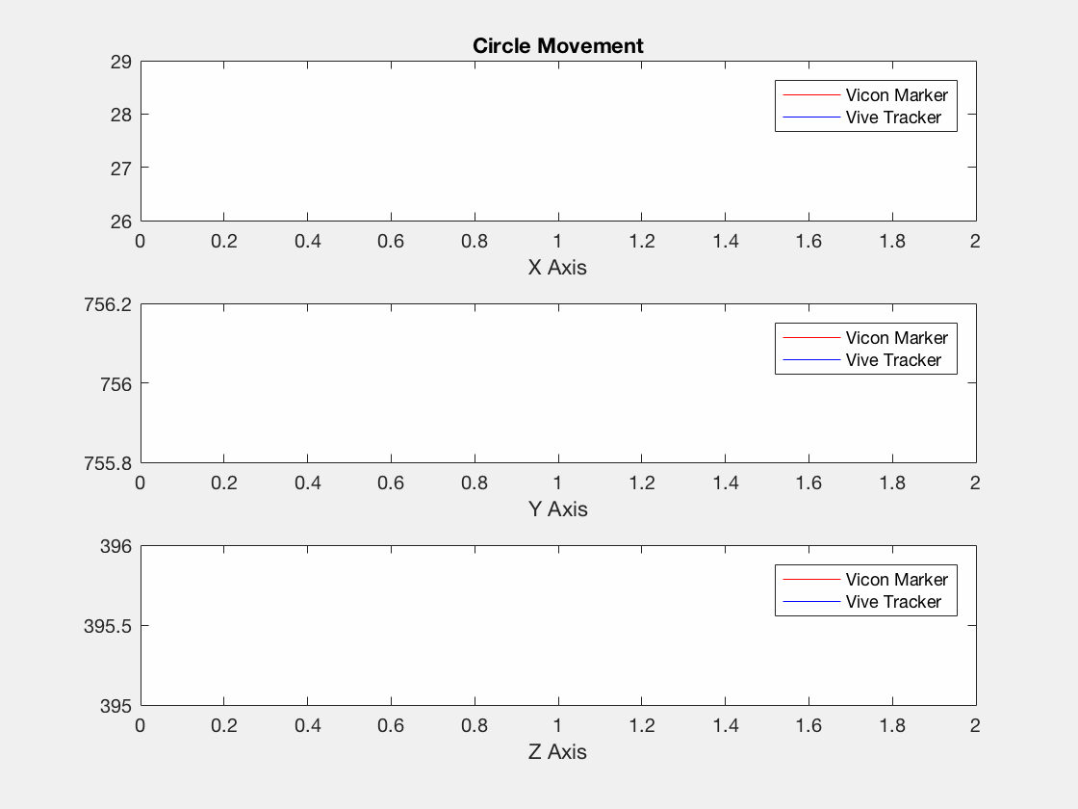
Error (mm)
RMS
Max
X Axis
4.2
17.4
Y Axis
4.5
14.4
Z Axis
2.6
10.0

Slide 14
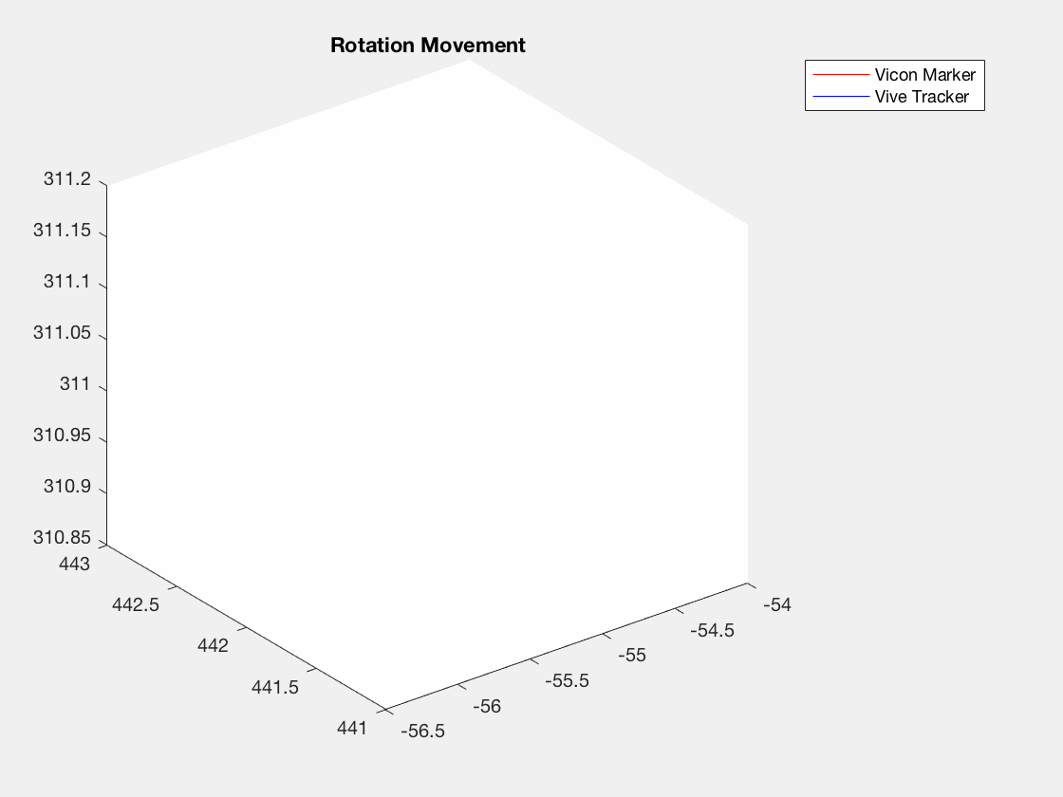
Rotation Movement
Geometric Error:
RMS(root mean square) Error: 5.0mm
Max Error: 24.3mm

Slide 15
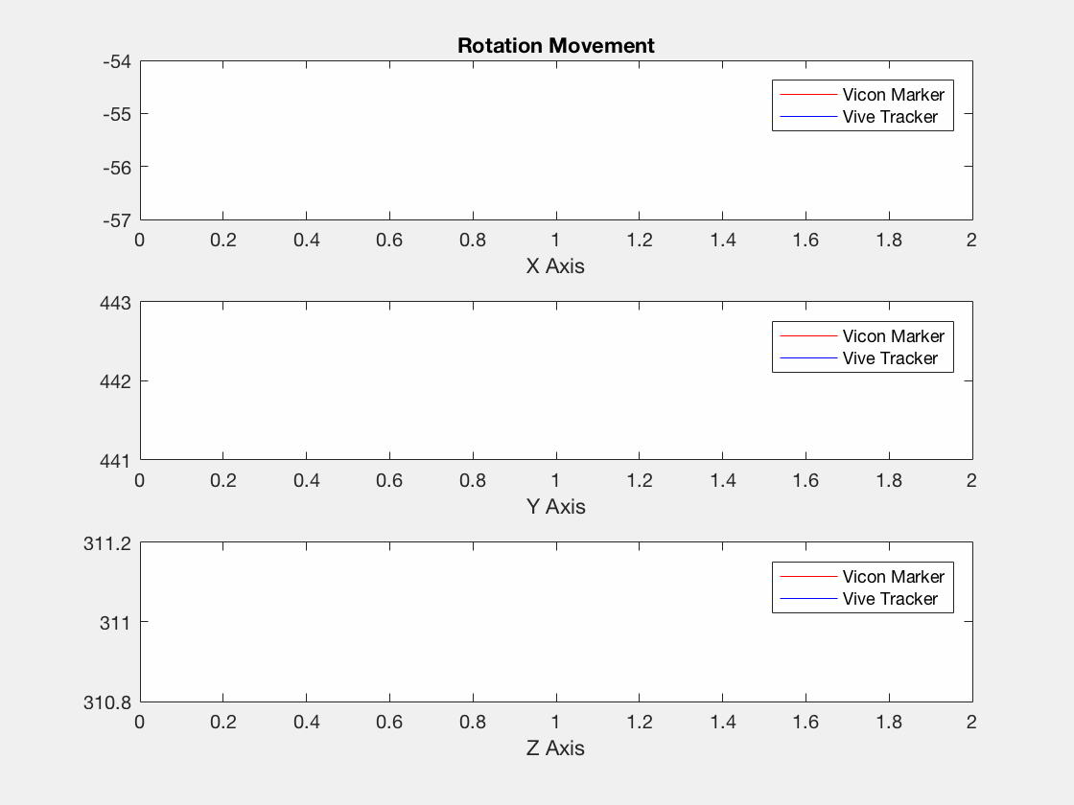
Error (mm)
RMS
Max
X Axis
4.1
23.8
Y Axis
2.0
6.8
Z Axis
3.2
19.8

Slide 16
Summary
Geometric Error
RMS
Max
Translation Movement
Circle Movement
Rotation Movement
2.7mm
10.2mm
6.7mm
30.2mm
5.0mm
24.3mm

Slide 17
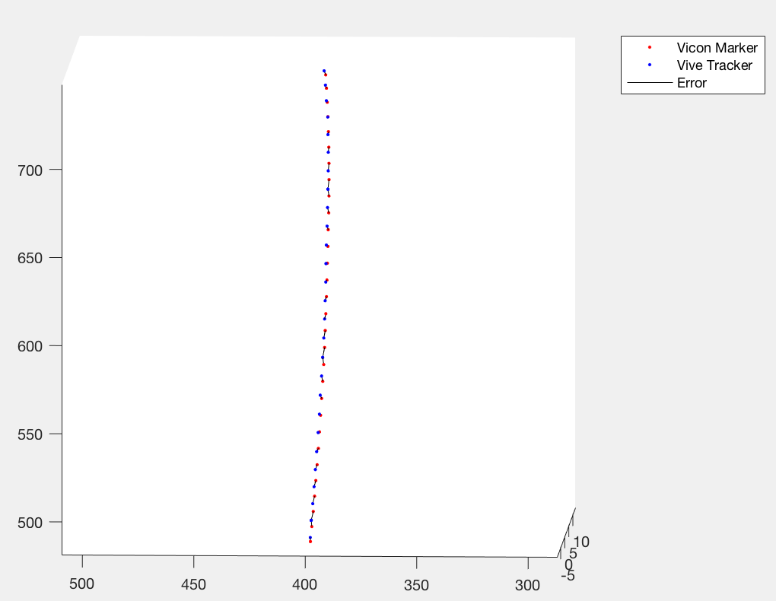
Error

Slide 18
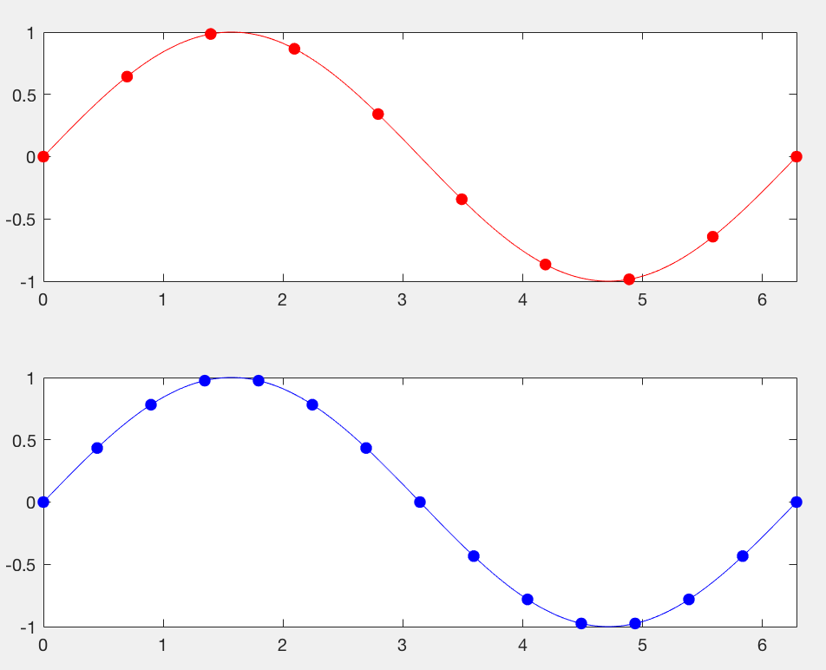
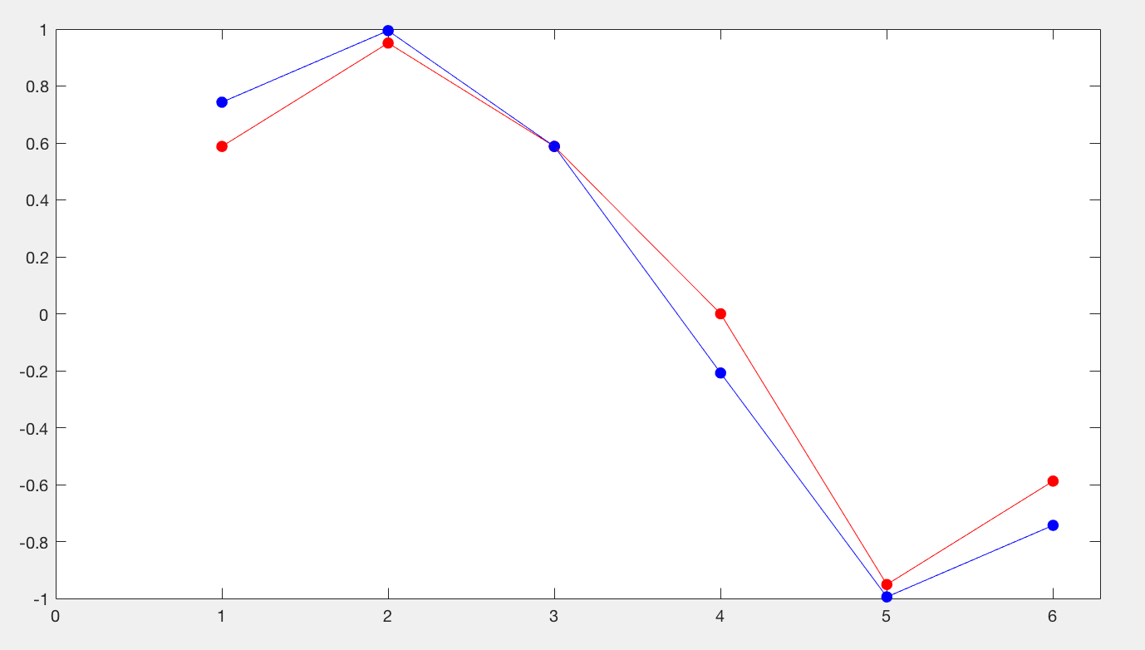
Delay Problem

Slide 19
Next Step
Compare orientation
Fix delay problem
The error for different speed

